Slide 1

Lecture 9: Effective ways of Teaching Grammar

Slide 2

tefljobsoverseas.com
E.g. We saw him book a ticket. It made me return home
The importance of
Grammar
Without assimilating the grammar mechanic, of the language, one may fail to understand the sentence or to express himself correctly.

Slide 3
According to Francis, there are “Three Meanings of Grammar”
First, grammar can be seen as “the set of formal patterns in which the words of a language are arranged in order to convey larger meanings.”
Next, when the teaching of grammar becomes a subject of scientific study, grammar becomes “the branch of linguistic science, which is concerned with the description, analysis, and formulization of formal language patterns.”

Slide 4
Definition of Grammar
3) From the third and last perspective grammar has been defined as linguistic etiquette focusing on the usage.
Neuleib (1977) defined grammar in line with Francis’s grammar, as “the internalized system that native speakers of a language share.”

Slide 5
Definition of Grammar
Fernandez (2011) defined grammar as “the underlying, implicit and abstract knowledge that humans have in their minds regarding the morphology and syntactic rules of their mother tongue.”

Slide 6
Freeman (2007) changed the term ‘Grammar’ to Grammaring and explaining it as the fifth skill which is to be taught dynamically and not as a fixed body of rules, so that the students can “use grammatical structures accurately, meaningfully, and appropriately.”

Slide 7
Brief Background of Grammar Teaching Approaches
“Formalists (Chomsky) [1950s] stressed structural description, Functionalists (Halliday) [1970s] saw grammar as the design of texts.
Even after the emergence of communicative approach to language teaching, the Functionalists’ approach of teaching grammar received prominence.
Grammar then becomes more content-based, meaningful and arises from the context.

Slide 8
The main approaches to teaching grammar
There are five major approaches to teaching grammar.
These are: a) Traditional Approach, b) Audiolingual Approach, c) Cognitive Code Approach, d) Comprehension Approach, and e) Communicative Approach.

Slide 9
Traditional Approach
Analysis of grammatical rules and translation of written pieces.
This approach, traditionally called Grammar-Translation Method (GTM) enabled students to read the literature and develop their minds in target language.

Slide 10
Audiolingual approach
Audiolingual Method (Army method) was introduced in the United States of America in the 1960s, which viewed language learning as a mechanical habit formation.
Certain key structures selected from dialogues are used as the basis for students’ pattern drills such as repetition, backward build-up, substitution, transformation, and question answer (Freeman, 2000).

Slide 11
Cognitive Code Approach
In the late 1960s Noam Chomsky, an advocate of Formalist approach to teaching grammar introduced the theory of Transformational Generative Grammar through Language Acquisition Device (LAD).
Chomsky believes that language acquisition is a cognitive psychological process rather than a product of habit formation.

Slide 12
Comprehension Approach
During 1970s and 1980s, practitioners presented grammar inductively letting learners discover the meaning from grammatical examples. During the same time, Communicative language Teaching (CLT) came into the scene.

Slide 13
Communicative approach
Since its introduction in 1970s, communicative approach to language teaching has been the most appreciated second language teaching methodology.
The objective of CLT, according to Canale and Swain Model (1980) has been developing competency of four components (strategic competence, discourse competence, grammatical competence, and sociolinguistic competence).

Slide 14
Useful techniques of teaching grammar
The very first technique in teaching grammar is to make grammar teaching context-based. To do so, we need to concentrate on the three major dimensions of linguistic units – form, meaning, and use as suggested by Freeman (2003).
“The English word house is a common count noun, it’s singular, it’s spelt with the silent e, it contains a dipthong, etc.
It has a meaning as well, of course. A house is a place where someone lives. However, we cannot stop there because there are a lot of words in English that refer to a place where someone lives. For example there is residence, dwelling, domicile, habitat, etc.
So, students have to learn to pick among them the appropriate word for the meaning that they want and for the context of use.”

Slide 15
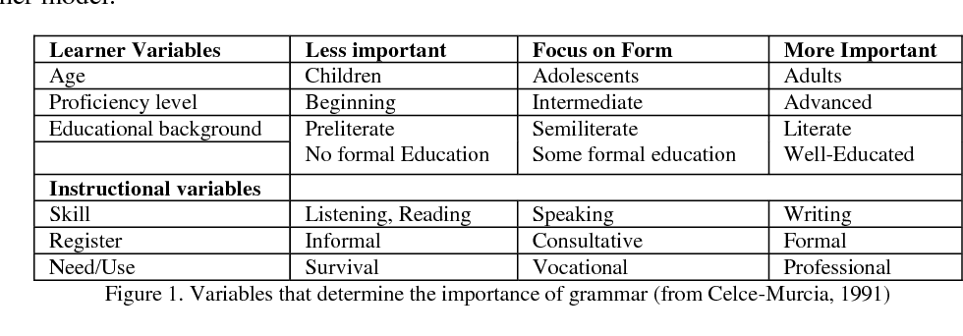
The model suggested by Murcia (1991)

Slide 16
Word order in English
The word order in: Tom gave Helen a rose indicates what was given (a rose), to whom (Helen), and by who, (Tom).
If we change the word order and say: Helen gave Tom a rose, we shall change the meaning of the sentence.

Slide 17
Types of Exercises for Assimilation of Grammar
Precognitive exercises
Drill exercises
Completion
Creative exercises (speech exercises)

Slide 18
Precognitive exercises
E.g. - Listen to the sentences and raise your hands whenever you hear the verbs in the Past Indefinite.
E.g. - Read the sentences in which (1) the action was not completed (she was reading a book), (2) the action was completed (she had read the book).
E.g. - Read the sentences and choose the correct form of the verb: I (go, went) to the library last Monday.

Slide 19
Drill exercises
Repetitive drill
Pupils pronounce the sentence patterns, dialogues after the teacher, or speaker in imitation of the teacher, both individually and in unison. E.g. They are dancing in the park.
Substitution
Pupils substitute the words or phrases in a sentence pattern.
E.g. The children are dancing in the park. (garden, street, yard, hall, etc.)

Slide 20
Completion
Pupils complete the sentences the teacher utters looking at the pictures he shows.
E.g. Teacher: Look at the picture. Mike is …
Grammar tests
Tests allow the teacher to evaluate pupils’ achievement in grammar.

Slide 21
Creative exercises (speech exercises)
1
Making statements either on the picture the teacher shows, or on objects.
2
Asking questions with a given grammar item.
3
Dramatising.
Translating into English and etc.
Speaking about the situation offered by the teacher.

Slide 22
Literature
1. Кунанбаева С.С. Современное иноязычное образование: методология и теории. - Алматы, 2005.-264с.
2.Гальскова Н.Д. Современная методика обучения иностранным языкам в школе. – М., 2000.
3.Кунанбаева С.С. Теория и практика современного иноязычного образования. Алматы. 2010. 344с
4.К.В. Фокина, Л.Н. Тернова, Н. В. Костычева. «Методика преподавания ин.языка», Высшее образование. 2008.

